Slide 1
HUMAN GENOME
Nov 16 2024
Giảng viên: TS. Lưu Phúc Lợi
Luu.p.loi@googlemail.com

Slide 2
Nội Dung Bài Báo Cáo
Human Genome Build
Introduction to UCSC Genome Browser
Introduction to GENCODE

Slide 3
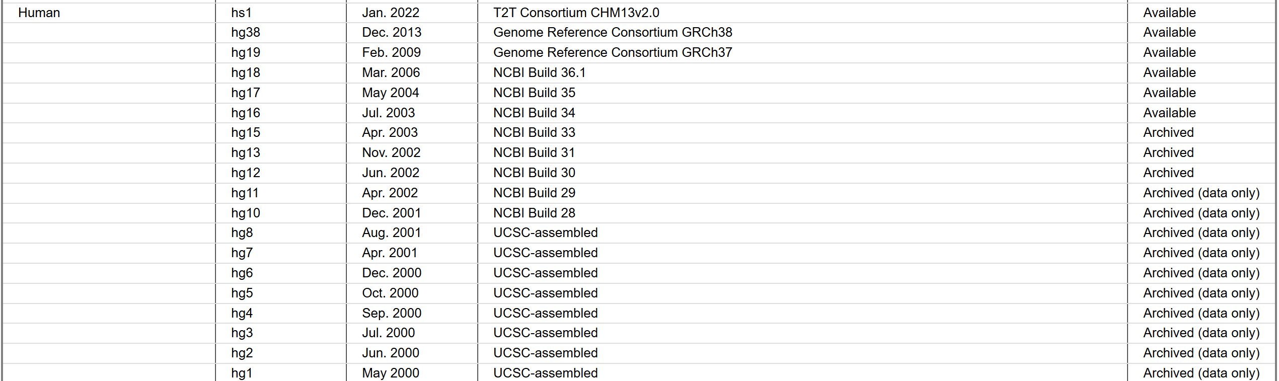
Human Genome Build
https://genome.ucsc.edu/FAQ/FAQreleases.html

Slide 4
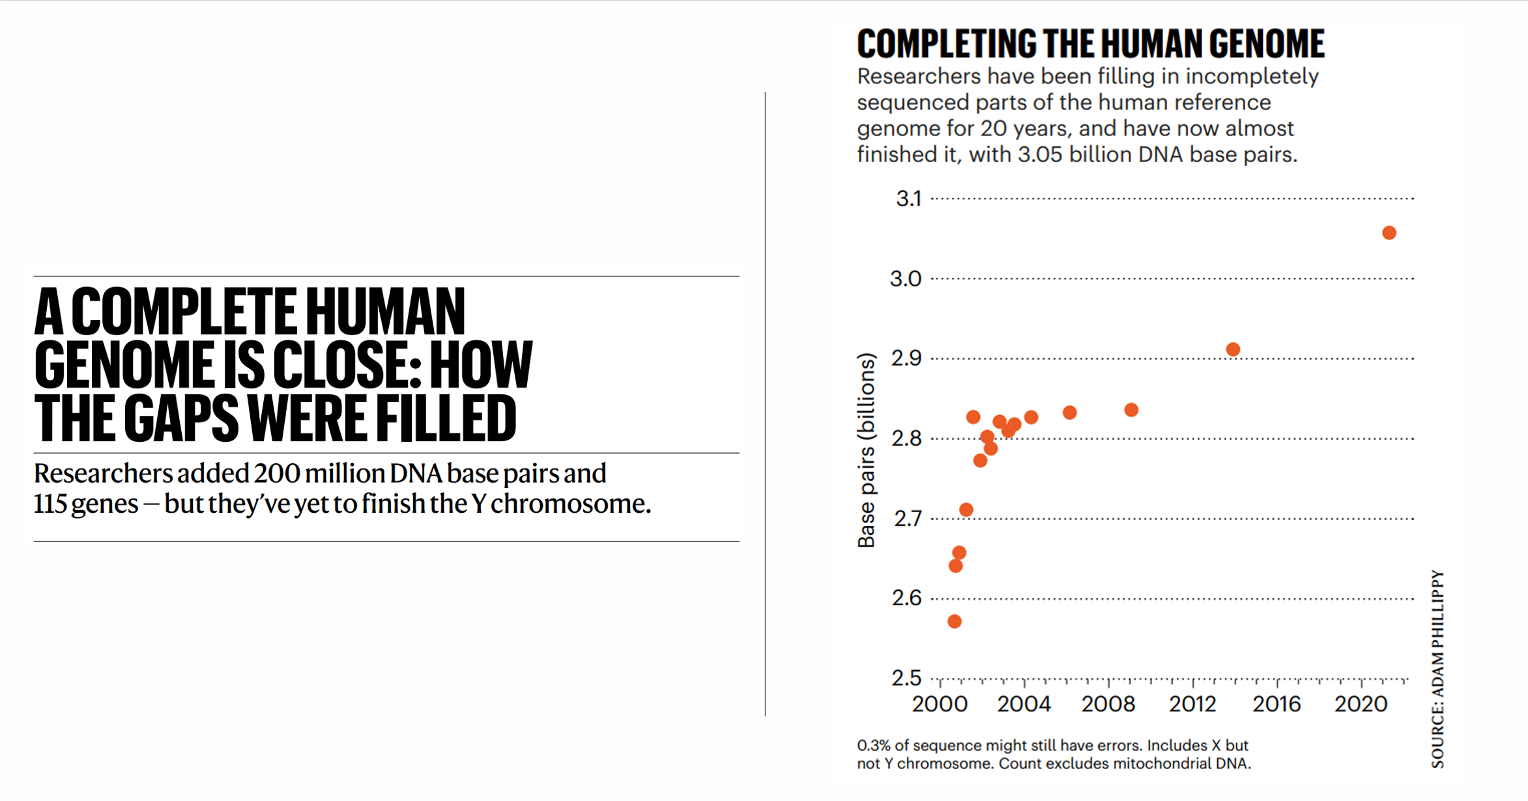

Slide 5
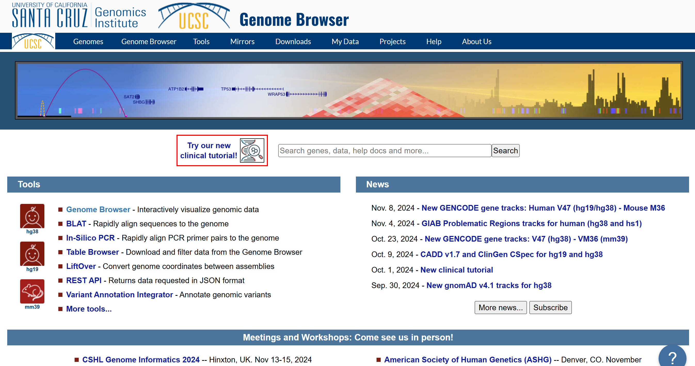
Introduction to UCSC Genome Browser
https://genome.ucsc.edu/index.html

Slide 6
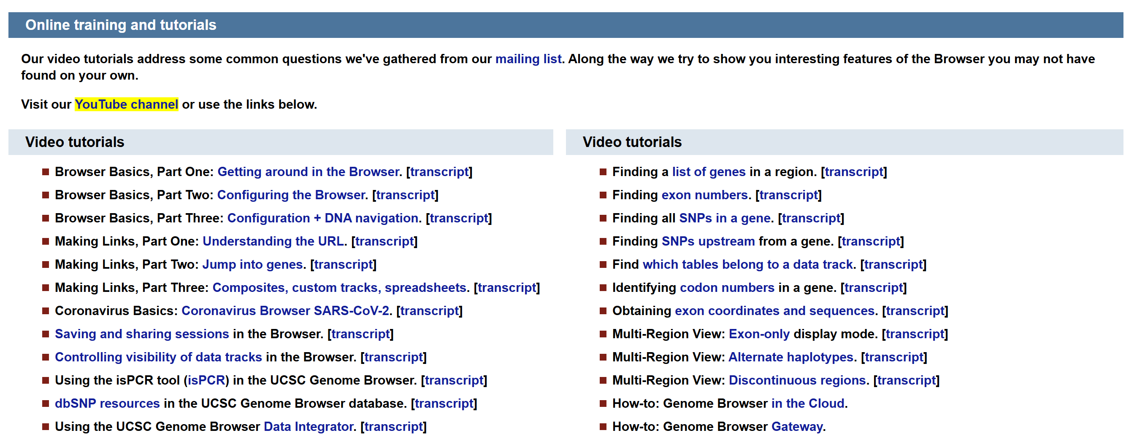
Getting Help with the UCSC Genome Browser
https://genome.ucsc.edu/training/

Slide 7
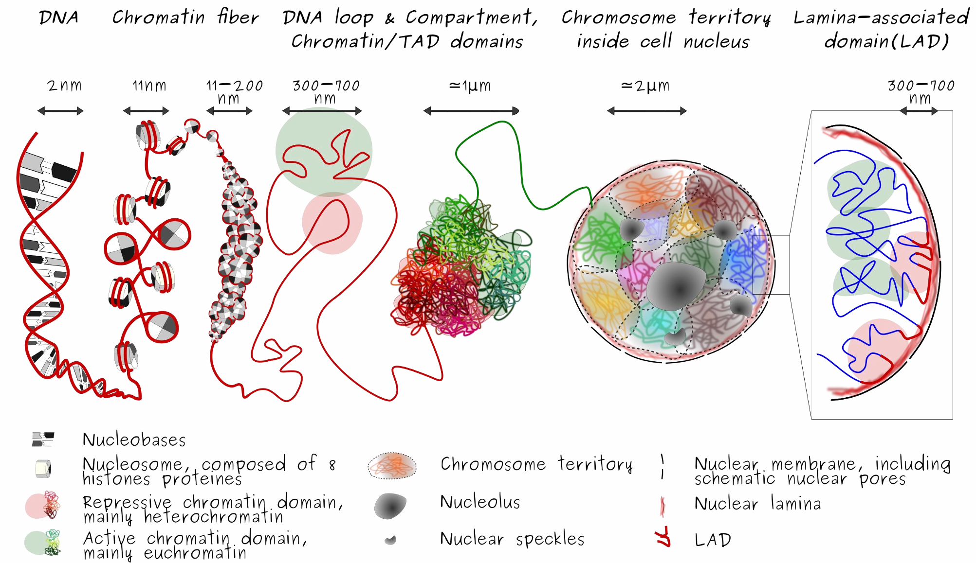
Human Genome Organization
index_3DOrgGenome_SquareShape.png (2523×1422)

Slide 8
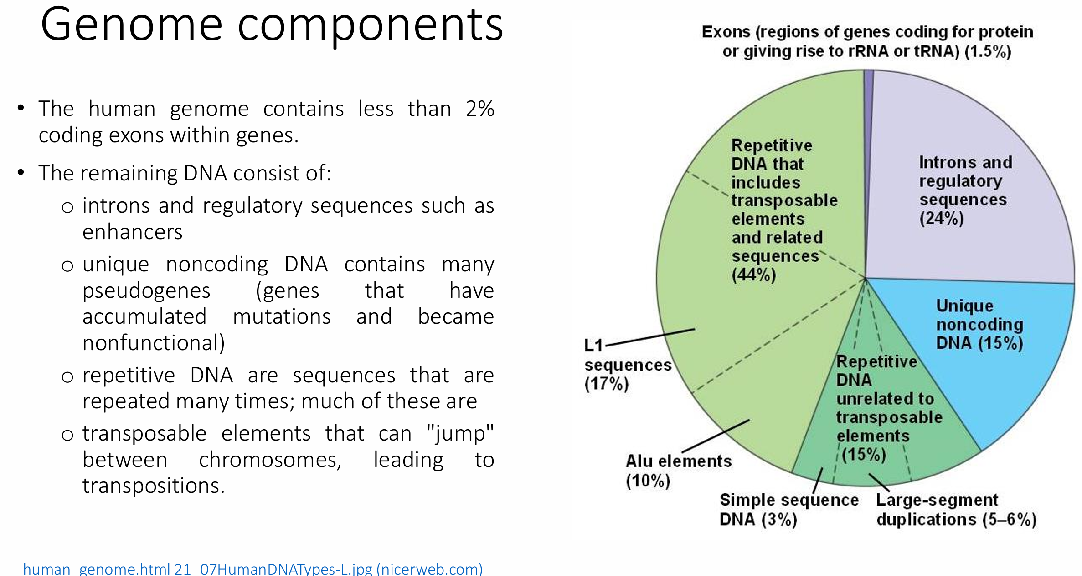

Slide 9
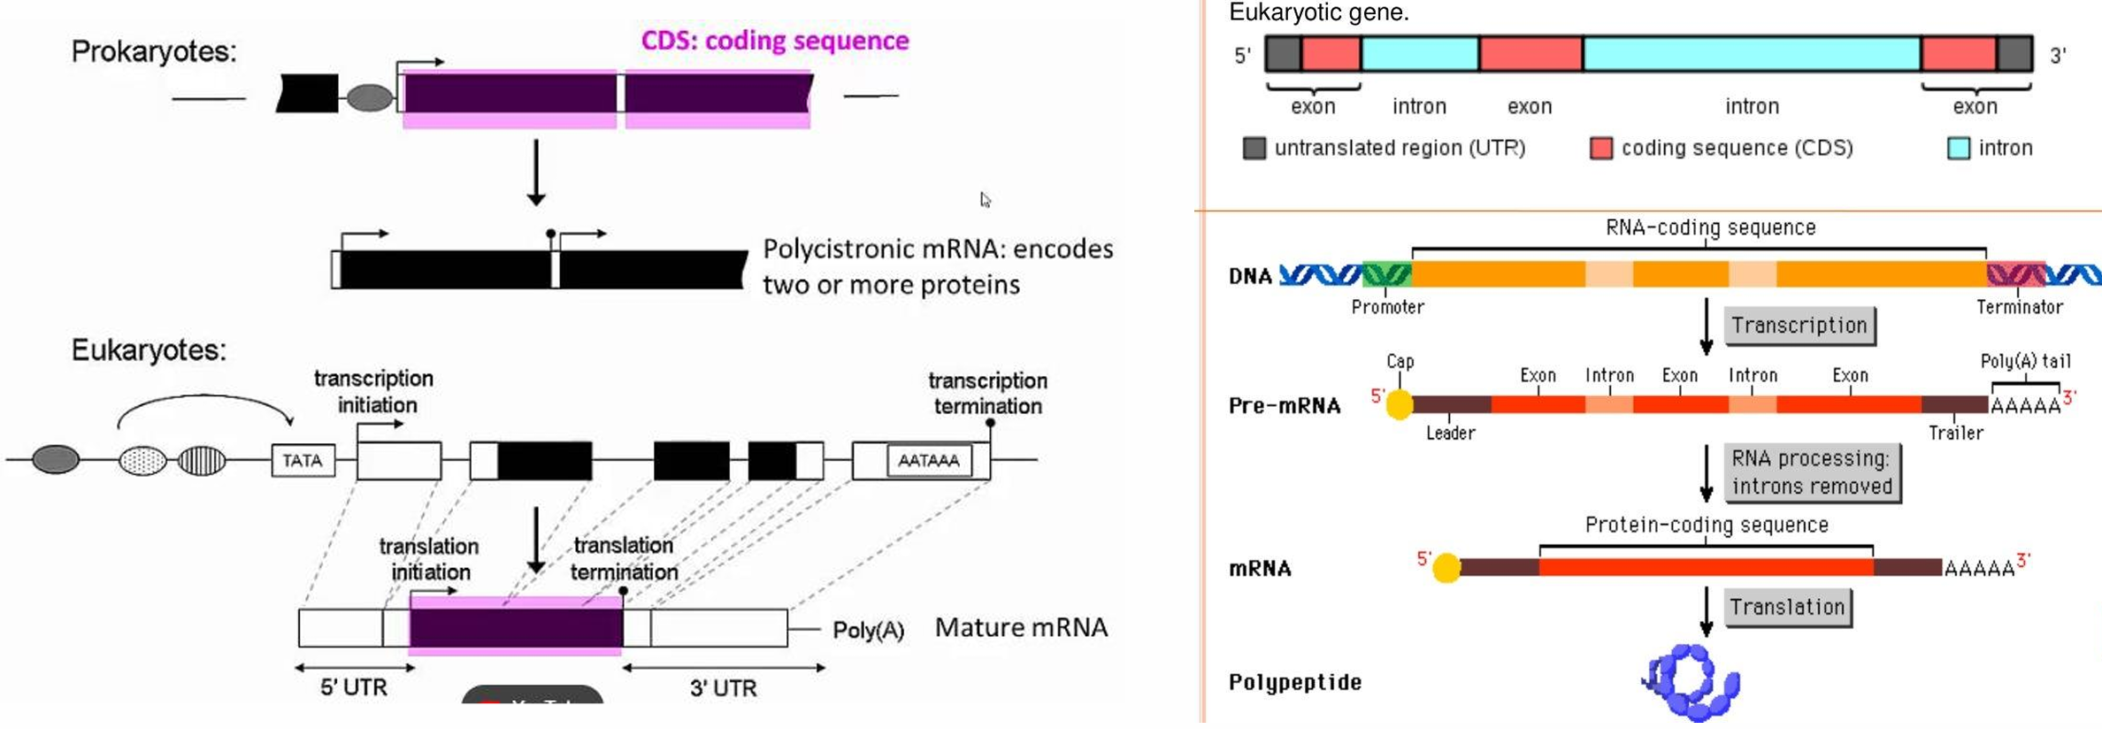
Gene structure

Slide 10
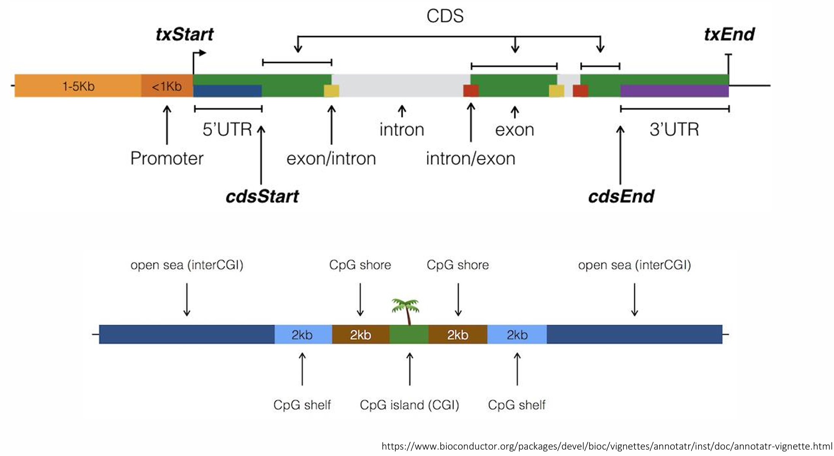
Gene structure

Slide 11
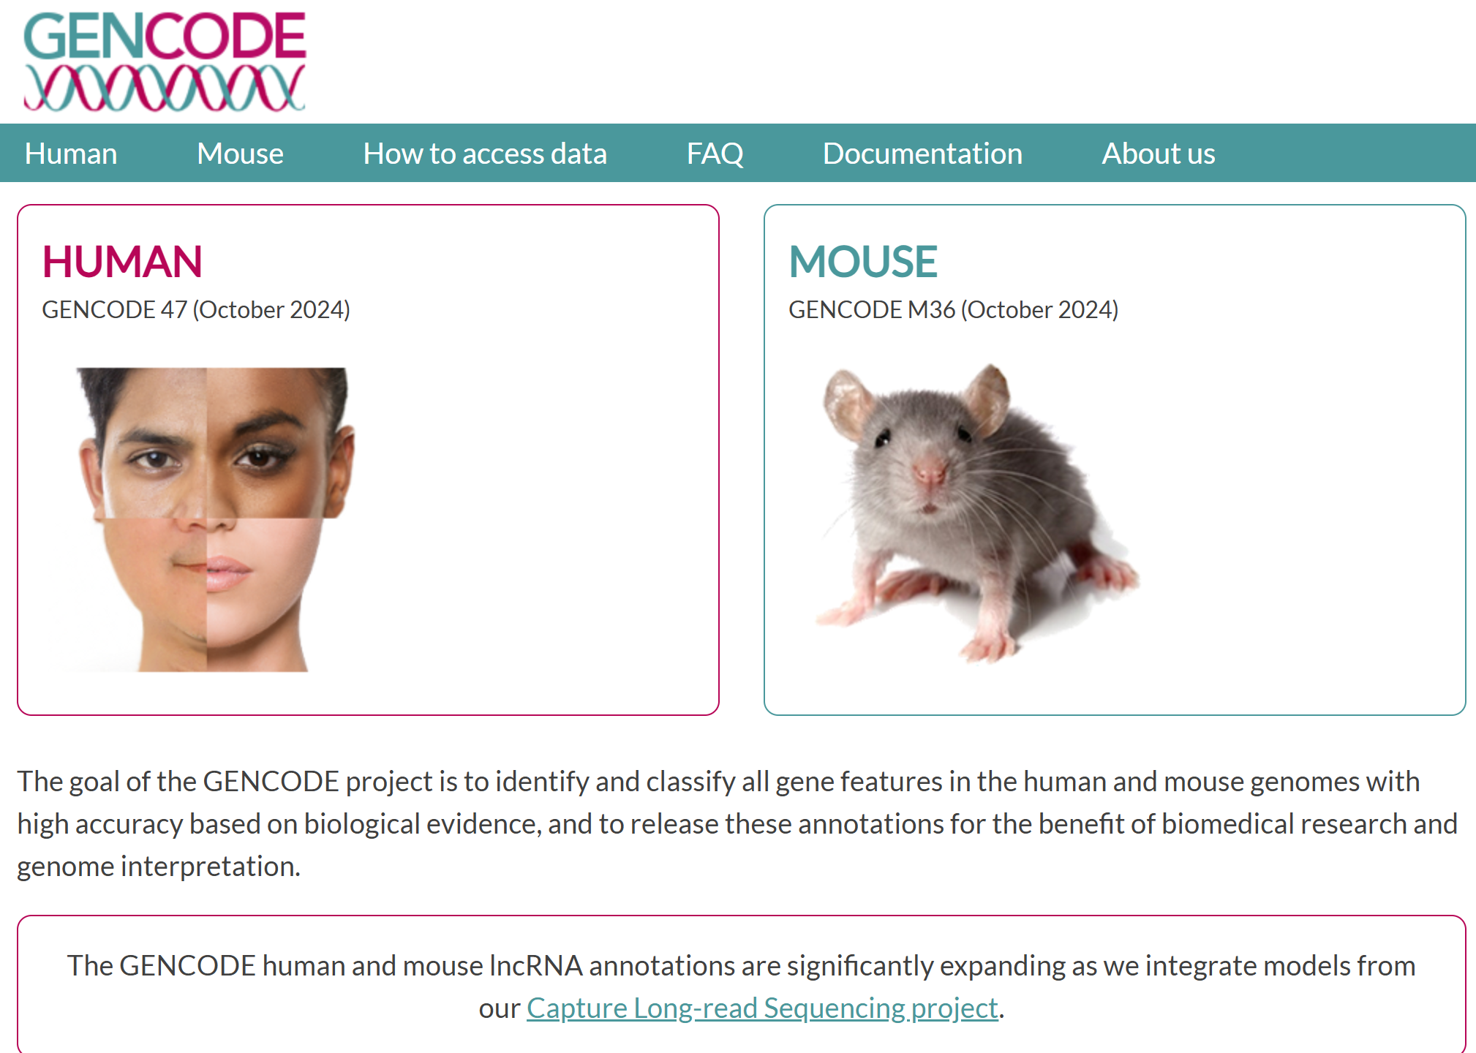
Understanding Gene Annotation through GENCODE (https://www.gencodegenes.org/)

Slide 12
Xin chân thành cảm ơn!
Luu Phuc Loi, PhD
Zalo: 0901802182
luu.p.loi@googlemail.com

